Slide 1

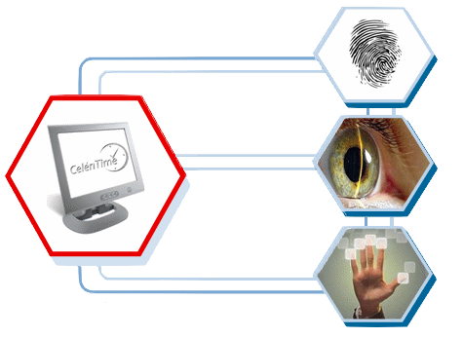
IICC DEPT OF RTMNU
Seminar
On
BIOMETRICES
Submitted To: Submitted By:
Mr. Shubh Thakre Sir Vaibhao A. Kamble
Notes:
1

Slide 2
Content
Introduction
What is Biometrics
History
Types
Characteristics
Biometrics Devices
Application
Advantages
Conclusion

Slide 3
Introduction
Biometrics are automated methods of recognizing a person based on a physiological or behavioral characteristic.
Biometrics technologies measure a particular set of a person's vital statistics in order to determine identity.

Slide 4
What is biometric?
The word "biometrics" is derived from the Greek words 'bios' and 'metric';
which means life and measurement respectively.
This directly translates into "life measurement".

Slide 5
History
The first real biometric system was created in 1870 by french anthropologist Alphonse Bertillion and turned biometrics a distinguished field of study.
The first classification method for fingerprints was developed in 1892 by Sir. Francis Galton. The

Slide 6
Types of Biometrics
Behavioral Biometrics- Used for verification .
Physical Biometrics- Used for either identification or verification.

Slide 7
Behavioral Biometrics
Speaker Recognition
Signature
Keystroke

Slide 8
Physical Biometrics
Fingerprint
Facial Recognition
Hand
Iris recognition
Vascular Patterns

Slide 9
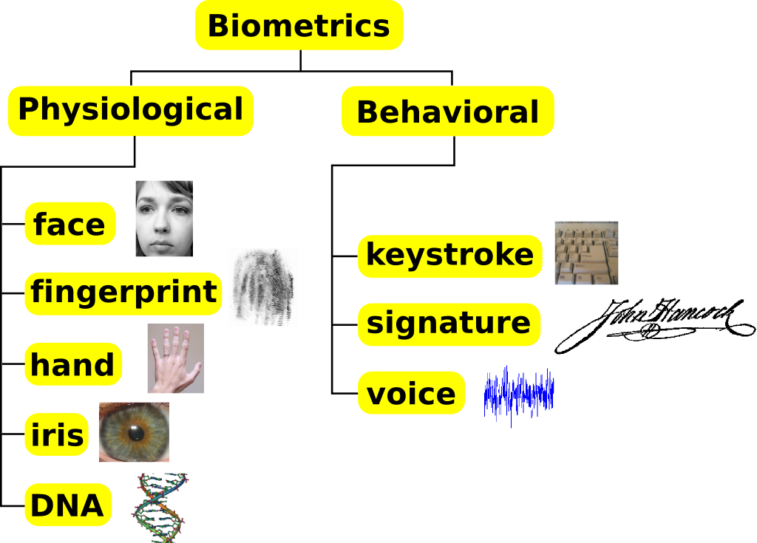
Characteristics of Biometric

Slide 10
Biometric Devices
Iris Scanner
Fingerprint Scanner
Face Camera
Retinal Scanning
DNA Matching

Slide 11
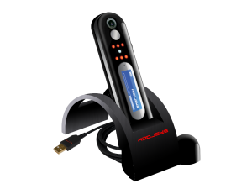
Iris Scanner

Slide 12
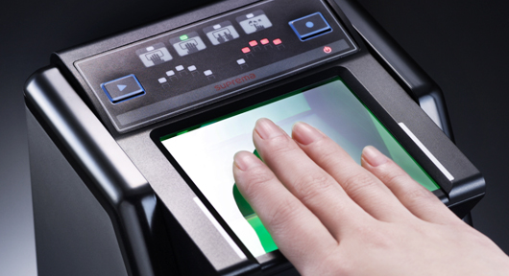
Fingerprint Scanner

Slide 13
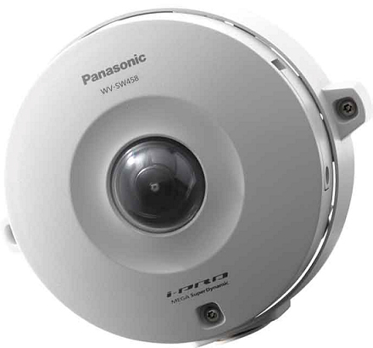
Face Camera

Slide 14
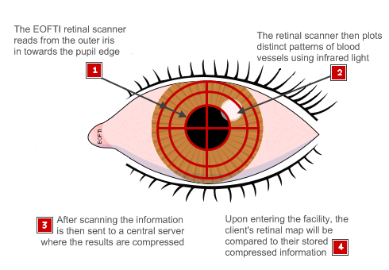
Retinal Scanning

Slide 15
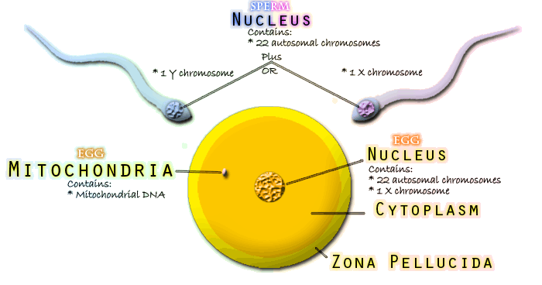
DNA Matching

Slide 16
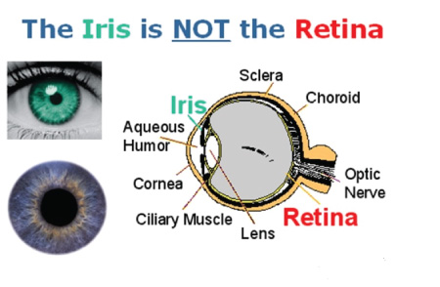
Iris V/S Retina

Slide 17
Applications
Biometric Time Clocks or Biometric time and attendance systems, which are being increasingly used in various organizations to control employee timekeeping.
Biometric safes and biometric locks, provides security to the homeowners.
Biometric access control systems, providing strong security at entrances.

Slide 18
Advantages
Increase security -Provide a convenient and low-cost additional tier of security.
Reduce password administration costs.
Replace hard-to-remember passwords which may be shared or observed.
Unequivocally link an individual to a transaction or event.

Slide 19
Conclusion
Biometrics can only be limited by limiting one's imagination.
Biometric technology is now being used in almost every area.
We have short listed a few highly popular applications of biometrics technology.

Slide 20
Thanks

